Slide 1
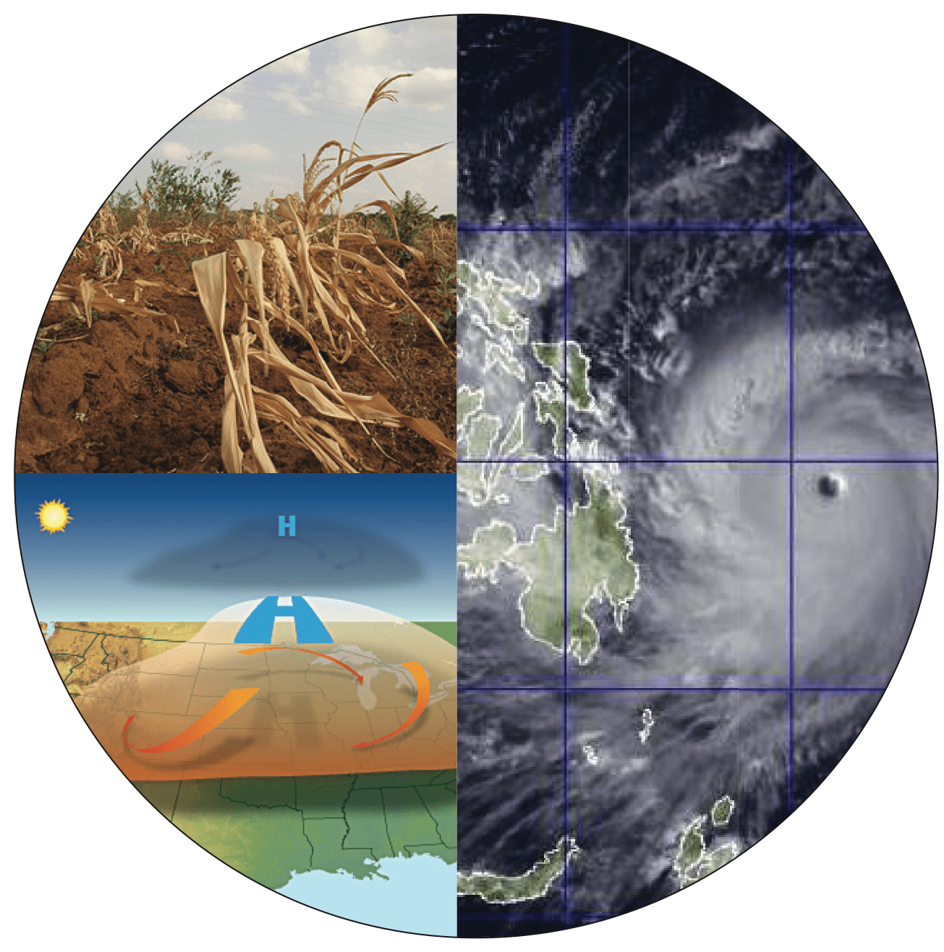

ENVIRONMENTAL SCIENCE
UNIT-5
ROLE OF INFORMATION TECHNOLOGY IN ENVIRONMENT
DEEPAK KUMAR S
2021111320

Slide 2


Context:
CONTEXT:
ROLE OF INFORMATION TECHNOLOGY
USE OF INFORMATION TECHNOLOGY
SIGNIFICANT ROLE OF INFORMATION TECHNOLOGY

Slide 3
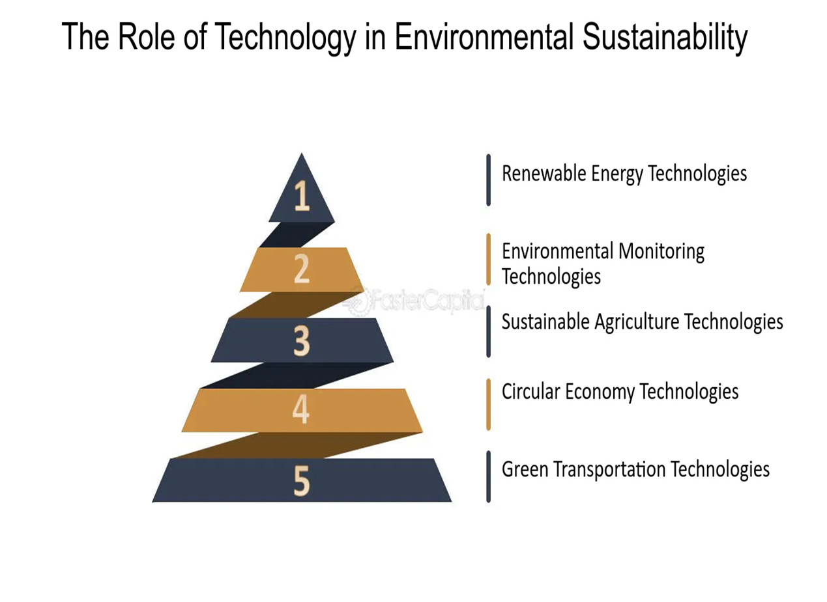
SIGNIFICANT ROLE OF INFORMATION TECHNOLOGY
Information technology plays a significant role in Environmental health and sanitation by providing tools and systems that can help monitor, track, and improve various aspects of environmental health and sanitation.

Slide 4
Monitoring environmental conditions: Information technology can be used to gather and analyze data on various environmental factors such as air and water quality, soil contamination, and the presence of pests and diseases. This information can help identify potential health hazards and inform efforts to mitigate them.
Tracking and managing waste: Information technology can be used to track and manage the generation, collection, and disposal of waste, including hazardous and medical waste. This can help ensure that waste is properly disposed of and reduce the risk of environmental contamination. Improving water and sanitation systems: Information technology can be used to design and manage water and sanitation systems, including systems for collecting, treating, and distributing clean water and for collecting and treating sewage. This can help improve public health by reducing the risk of waterborne diseases.
Promoting sustainable practices: Information technology can be used to promote sustainable practices, such as energy efficiency and conservation, by providing tools and systems for tracking and managing resource use. This can help reduce the environmental impact of human activities and improve public health.
Overall, the use of information technology in environmental health and sanitation can help identify and address potential health hazards, improve the efficiency and effectiveness of environmental health and sanitation systems, and promote sustainable practices.

Slide 5
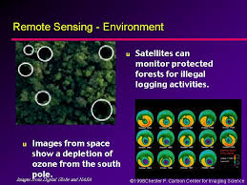
Role of Information Technology in Environment: The important roles of information technology in environment are as follows:
1. Remote Sensing:
Remote sensing technique through satellite can be used to assess ongoing changes in the environment and to predict natural calamities like droughts, floods and volcanic eruptions etc. The technique is of great use in exploring the possible availability of crude oils, mineral deposits and location of geothermal power sources.

Slide 6
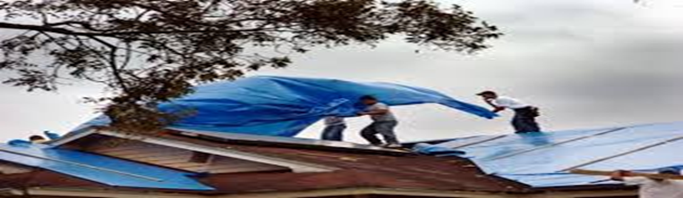
Applications for Remote Sensing of the Environment
Disaster Relief: Teams can use remote sensing to quickly evaluate damage and help them prioritize relief efforts. For an example: Operation Blue Roof
Operation Blue Roof: is a program offered by FEMA through the U.S. Army Corps of Engineers to eligible homeowners and landlords. It provides a temporary covering of blue plastic sheeting to help reduce further damage to property until permanent repairs can be made.
Disaster Risk Management: From tracking storms to identifying areas at high risk for flooding, remote sensing provides the information communities need to prepare for the worst.
Conservation and Ecological Management: remote sensing to identify various plant and wildlife species in an area, allowing them to track trends and monitor changes over time by identifying invasive species, seeing the effects of introducing new wildlife, and mapping sensitive ecosystems.
Fighting Wildfires: Teams use remote sensing of the environment to identify hot spots that aren’t visible from the ground, so they can address them before they become a real threat. They also use remote sensing data combined with other information, such as wind speed and direction, to make predictions and plan their efforts accordingly.
Land Management: Remote sensing can show how land has changed over time, including areas of soil erosion, vegetation density, and other markers used to inform conservation strategies.
Waterway Management: monitor important metrics of our waterways, such as pollution of local rivers and streams and global sea ice levels

Slide 7
2.Database:
Database is the collection of inter-related data on various subjects. It is usually in computerized form and can be retrieved whenever required. There are several Distribution Information Centers (DICs) in our country that are linked with each other and with the central information network having access to international database. The Ministry of Environment and Forests, Government of India has taken up the task of compiling a database on issues like wildlife, forest cover, wastelands etc.
3.Environmental Information System (ENVIS):
ENVIS established in 1982 aims on providing environmental information to decision makers, policy planners, engineers and scientists all over the country. ENVIS centers work for generating a network of database in areas like pollution control, clean technologies, biodiversity, renewable energy, wildlife, environmental management and remote sensing.

Slide 8
Objectives of ENVIS:
To build up a repository and dissemination centre in Environmental Science and Engineering.
b. To gear up modern technologies of acquiring, processing, storage, retrieval and dissemination of information of environmental nature.
c. To promote research, development and innovation in environmental information technology.
d. To provide national environmental information service relevant to meet the future needs.

Slide 9
4.National Management Information System (NMIS):
NMIS of the Department of Science and Technology has compiled a database on Research and Development projects along with information about research scientists and personnel involved.
5.Geographical Information System (GIS):
GIS has proved to be a very effective tool in environmental management. GIS is a technique of superimposing various thematic maps using digital data on a large number of inter-related or inter-dependent aspects. Different thematic maps containing digital information on a number of aspects like water resources, forest land, soil type, crop land, industrial growth, human settlement etc. are superimposed in a layered form in computer using soft-wares.

Slide 10
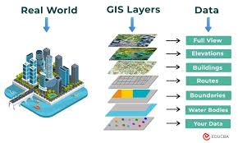

Slide 11
THANK YOU.

